Slide 1
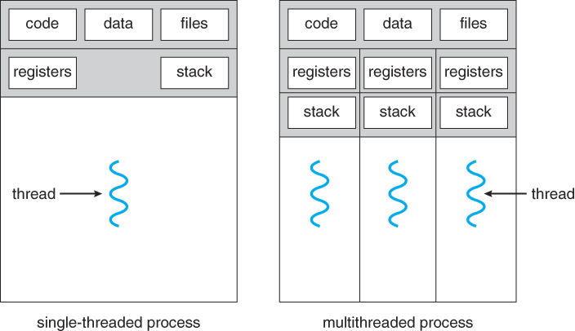
Multithreading
https://www.cs.uic.edu/~jbell/CourseNotes/OperatingSystems/4_Threads.html

Slide 2
Reference
Horstmann, Cay. Big Java, 2nd edition, 2006. Wiley. 0-471-69703-6.
See chapter 23
Notes:
Big Java, 2nd edition, Chapter 10

Slide 3
Parallel Processing
programs can execute faster if tasks can be run in parallel
calculations on large sets of numbers can be done faster if some of the operations can be done in parallel
(1 + 3 ) * (2 + 7)
in an animation, different tasks can work on computing the positions of different parts of the animation
find 1+3 and 2+7 in parallel, then add results

Slide 4
Processes
a process is a self-contained execution environment
every process has its own resources – for example, each process has its own memory space
most implementations of the JVM (Java Virtual Machine) run as a single process (see http://docs.oracle.com/javase/tutorial/essential/concurrency/procthread.html for more details)
Notes:
http://java.sun.com/docs/books/tutorial/essential/concurrency/procthread.html

Slide 5
Threads
a thread is a program unit that executes independently of other parts of the program
threads exist within a process – every process has at least one thread
threads are sometimes called lightweight processes
Notes:
http://java.sun.com/docs/books/tutorial/essential/concurrency/procthread.html

Slide 6
Multithreaded Process
https://www.cs.uic.edu/~jbell/CourseNotes/OperatingSystems/4_Threads.html

Slide 7
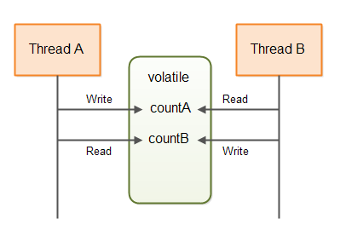
Threads
threads consume fewer resources than processes – they have their own execution environment, but they may share the process’s memory
http://tutorials.jenkov.com/images/java-concurrency/non-blocking-algorithms-4.png

Slide 8
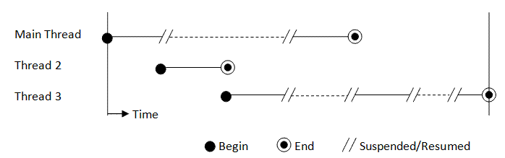
Threads
in most cases, the JVM executes each thread for a short period of time, then switches to another thread
this gives the illusion of running in parallel, but really isn’t
http://www3.ntu.edu.sg/home/ehchua/programming/java/images/Multithread.gif
Notes:
http://www.javamex.com/tutorials/threads/
http://www.javamex.com/tutorials/threads/how_threads_work.shtml
http://www.javamex.com/tutorials/threads/thread_scheduling.shtml

Slide 9
Threads
most computers now have multiple processors
this allows two threads to execute at the same time, for real parallel processing, but not all applications can take advantage of multiple processors

Slide 10
Running Threads in Java
to run a thread in Java
define a class that implements the Runnable interface
write your run() method of the Runnable interface
instantiate an object of your class
construct Thread object from the object you instantiated
call start() method of the Thread object
in driver class

Slide 11
GreetingRunnable.java
public class GreetingRunnable implements Runnable
{
private String greeting;
private static final int REPETITIONS = 10;
private static final int DELAY = 1000;
public GreetingRunnable(String aGreeting)
{
greeting = aGreeting;
}

Slide 12
GreetingRunnable.java
public void run() {
for(int i = 1; i <= REPETITIONS; i++) {
try {
Date now = new Date();
System.out.println(now + " " + greeting);
Thread.sleep(DELAY);
} catch (InterruptedException ex){
System.out.println("Interrupt");
return;
}
}
}
}

Slide 13
GreetingThreadTester.java
public class GreetingThreadTester {
public static void main(String[] args) {
GreetingRunnable r1 =
new GreetingRunnable("Hello, World!");
GreetingRunnable r2 =
new GreetingRunnable("Goodbye, World!");
Thread t1 = new Thread(r1);
Thread t2 = new Thread(r2);
t1.start();
t2.start();
}
}

Slide 14
Output
Sun Nov 18 15:51:46 CST 2012 Goodbye, World!
Sun Nov 18 15:51:46 CST 2012 Hello, World!
Sun Nov 18 15:51:47 CST 2012 Goodbye, World!
Sun Nov 18 15:51:47 CST 2012 Hello, World!
Sun Nov 18 15:51:48 CST 2012 Hello, World!
Sun Nov 18 15:51:48 CST 2012 Goodbye, World!
Sun Nov 18 15:51:49 CST 2012 Hello, World!
Sun Nov 18 15:51:49 CST 2012 Goodbye, World!
Sun Nov 18 15:51:50 CST 2012 Goodbye, World!
Sun Nov 18 15:51:50 CST 2012 Hello, World!
Sun Nov 18 15:51:51 CST 2012 Hello, World!
Sun Nov 18 15:51:51 CST 2012 Goodbye, World!
Sun Nov 18 15:51:52 CST 2012 Hello, World!
Sun Nov 18 15:51:52 CST 2012 Goodbye, World!
Sun Nov 18 15:51:53 CST 2012 Hello, World!
Sun Nov 18 15:51:53 CST 2012 Goodbye, World!
Sun Nov 18 15:51:54 CST 2012 Hello, World!
Sun Nov 18 15:51:54 CST 2012 Goodbye, World!
Sun Nov 18 15:51:55 CST 2012 Hello, World!
Sun Nov 18 15:51:55 CST 2012 Goodbye, World!

Slide 15
Terminating Threads
a thread terminates when the run method associated with the thread terminates
sometimes you want to terminate a thread manually
initially, the Thread class had a stop method, but it is now deprecated and should not be used

Slide 16
Terminating Threads
Do not stop a thread abruptly
Use the interrupt method
Notifies the thread that it needs to stop
gives it time to clean up (e.g releasing any resources it is holding)

Slide 17
Interrupting a Thread
When interrupt is called
a boolean field in the thread data structure is set
the run method can check for interruptions
if it finds the interrupt flag is set:
it can do any required cleanup
then exit

Slide 18
Interrupting a Thread
public static void main(String[] args)
{
GreetingRunnable r1 = new
GreetingRunnable("Hello, World!");
GreetingRunnable r2 = new
GreetingRunnable("Goodbye, World!");
Thread t1 = new Thread(r1);
Thread t2 = new Thread(r2);
t1.start();
t2.start();
t1.interrupt();
}

Slide 19
Output
Sun Nov 18 16:04:43 CST 2012 Goodbye, World!
Sun Nov 18 16:04:43 CST 2012 Hello, World!
Interrupted Exception
Sun Nov 18 16:04:44 CST 2012 Goodbye, World!
Sun Nov 18 16:04:45 CST 2012 Goodbye, World!
Sun Nov 18 16:04:46 CST 2012 Goodbye, World!
Sun Nov 18 16:04:47 CST 2012 Goodbye, World!
Sun Nov 18 16:04:48 CST 2012 Goodbye, World!
Sun Nov 18 16:04:49 CST 2012 Goodbye, World!
Sun Nov 18 16:04:50 CST 2012 Goodbye, World!
Sun Nov 18 16:04:51 CST 2012 Goodbye, World!
Sun Nov 18 16:04:52 CST 2012 Goodbye, World!

Slide 20
What Can Go Wrong?
race conditions – two threads compete for the same resources
unpredictable results, depending on who gets the resource first
fix by using locks
locks not released
fix by using finally
deadlock
fix by using conditions

Slide 21
Race Conditions
if two threads have shared resources and the effect of the two threads depends on the order in which the threads are scheduled, we have a race condition
the two threads race to complete their tasks and the outcome depends on which one wins

Slide 22
Example
two threads are updating a bank account – one is withdrawing $100 and the other is depositing $100, so final balance should be the same as the starting balance
the next slide shows what happens when things go terribly wrong ! ☹

Slide 23
Example
initial balance is 0
thread 1 reads initial balance of 0
thread 2 reads initial balance of 0
thread 1 deposits 100 and calculates (but does not store) the new balance of 100
thread 2 withdraws 100 and calculates (but does not store) the new balance of -100
thread 2 stores new balance of -100
thread 1 stores new balance of 100
ERROR: final balance is 100! (and could have been -100 if thread order had been different)

Slide 24
Synchronization
to solve the problems associated with threads running concurrently, we can use a lock object
the lock object controls the threads attempting to use shared resources
Java 5.0 (and above) has a Lock interface and several classes implementing this interface

Slide 25
The ReentrantLock Class
the most commonly used lock class is the ReentrantLock class
you can add a ReentrantLock object to a class whose methods access shared resources
balanceChangeLock = new ReentrantLock();

Slide 26
Methods lock and unlock
you then surround code that manipulates the shared resource with lock and unlock method calls
balanceChangeLock.lock();
code manipulating shared resource
balanceChangeLock.unlock();
when a thread acquires a lock, no other thread can acquire a lock for the same resource, until the first thread releases the lock

Slide 27
Handling Exceptions
PROBLEM: if exception thrown between calls to lock and unlock, the call to unlock never occurs
this is serious: the thread that threw the exception will continue to hold the lock and no other thread can acquire the resource

Slide 28
Handling Exceptions
SOLUTION: surround code manipulating shared resource with try, and place unlock in finally block
try block can be followed by:
a catch block, a finally block, or both
finally block is always executed, no matter how the try block is exited

Slide 29
Handling Exceptions
balanceChangeLock.lock();
try
{
code manipulating shared resource
}
finally
{
balanceChangeLock.unlock();
}

Slide 30
Deadlock
we have yet another problem to deal with – deadlock!
suppose we want to disallow negative balances to our bank account
we add a test, inside the try block of the withdraw method:
if the balance < the amount being withdrawn, we wait until the balance grows

Slide 31
Deadlock
how do we wait for balance to grow?
if the thread sleeps, it will block other threads trying to acquire the same lock it is holding
so other threads can call deposit but will be blocked by withdraw method
but the withdraw method can’t complete until a deposit is made
DEADLOCK!

Slide 32
Condition Objects
Conditions allow an object to temporarily release a lock and then to regain it later
a condition belongs to a lock object
the newCondition method allows a lock to obtain a condition
sufficientFundsCondition = balanceChangeLock.newCondition

Slide 33
Releasing the Lock
Call the await method of the Condition object to:
make thread holding lock wait
allow another thread to acquire the lock object
a thread that calls await is not deactivated the way a thread that reaches the end of its time slice is deactivated – it is in a blocked state

Slide 34
Example
in the method allowing withdrawals
balanceChangeLock.lock();
try {
while(balance < amount) {
sufficientFundsCondition.await();
}
...
}finally{
balanceChangeLock.unlock();
}

Slide 35
Re-acquiring the Object
to unblock the blocked thread, another thread has to execute the signalAll method on the same condition object
the signalAll method unblocks all threads waiting on the condition, so they can all compete for the lock object
eventually one gains access and exits from the await method

Slide 36
Example
in the method allowing deposits
balanceChangeLock.lock();
try
{
...
sufficientFundsCondition.signalAll();
}finally
{
balanceChangeLock.unlock();
}

Slide 37
Synchronized Methods
the Lock and Condition classes were added in Java 5.0
earlier Java versions used synchronized methods, which we will discuss briefly

Slide 38
Synchronized Methods
every Java object has one built-in lock and one built-in condition
if a synchronized method is called, the lock is automatically created
you can make any method synchronized by simply adding the synchronized keyword to the method header
public synchronized void deposit(double amt)

Slide 39

Synchronized Methods
when you use the synchronized keyword, the lock/try/finally/unlock code is automatically implemented (it doesn’t appear in the code, but the method works in the same manner as if it were included)

Slide 40
Synchronized Methods
the single condition provided makes it possible for one method to wait on another
simply include a wait() statement in the method that should be waiting
while(balance < amount) {wait();}
and have another method call notifyAll:
notifyAll();

Slide 41
Synchronization Vs. Lock Objects
synchronized methods are easier to use than Lock and Condition objects
however, they are also more limited
if a synchronized method will do, use it
otherwise, use Lock and Condition objects

Slide 42
Multithreading
The End

